Slide 1


LOG-OUT OF FMIS
When a user has finished their FMIS session, click ‘File’ in the menu bar and select ‘Exit.’ Not properly logging-out can prompt Issue 2 mentioned in ‘Common Log-In Issues and Resolutions.’
Important Note: Users will be automatically logged-out of FMIS after fifteen minutes of inactivity.
U.S. General Services Administration
The Financial Management Information System
SYSTEM ACCESS
AND LOG-IN
QUICK REFERENCE CARD
This Quick Reference Card is designed to provide users of FMIS with an understanding of how to access the system and distinguish between the various log-in screens.
KEY TAKE-AWAYS: To understand how to successfully log-in to FMIS and trouble-shoot application access issues
Last Updated: March 2011
FMIS RESOURCES
FMIS User Guide
FMIS Quick Reference Cards:
System Access and Log-In
Saving and Printing Data
VAT Data Collection Process
Queries
Frequently Used Queries
For additional support with FMIS, please contact the OCFO Service Desk at ocfoservicedesk@gsa.gov

Slide 2
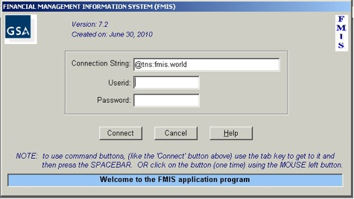

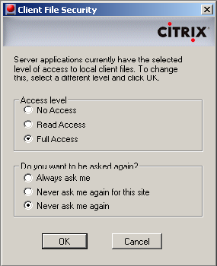
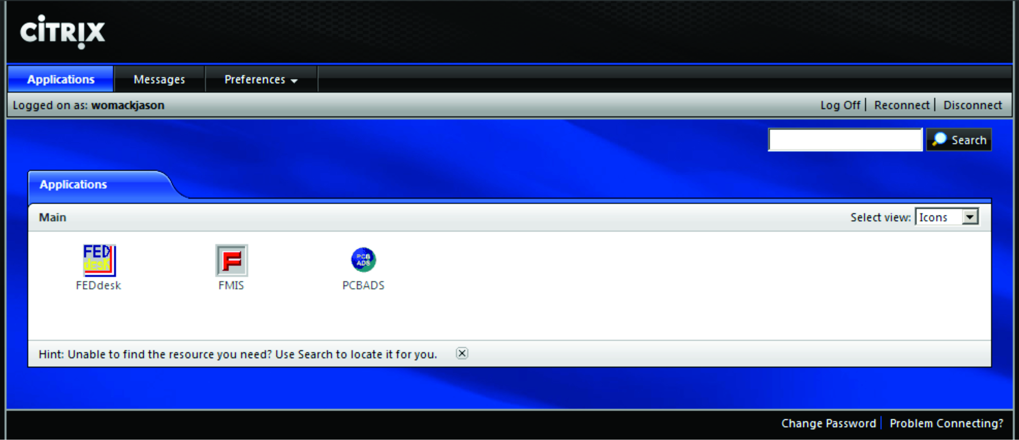
NAVIGATING TO FMIS
GSA users should access FMIS by navigating to:
http://cfo.fmis.gsa.gov
Users outside of GSA’s network can access FMIS at:
https://xpwi.gsa.gov
Important Note: It is recommended that users use Internet Explorer to access FMIS. Also, users must have the Citrix plugin installed. The Citrix plugin is available at https://ras.gsa.gov, or by contacting the GSA IT Service Desk at ITServiceDesk@gsa.gov
LOG-IN TO FMIS
Click the FMIS icon in the middle of the screen. Users will then go through two logon verifications:
At the first log-in screen, the Citrix Server Logon, users should type their FMIS ID, and their password. Users will be prompted to update this password after logging-in for the first time.
After successfully logging-in to the NT Server, users will be directed to the Citrix Application Menu – double click the FMIS icon to launch the application.
Users will be prompted by a second log-in screen to log on to FMIS. Here, users should type their FMIS ID and their password. The Connection String field should default to ‘@tns:fmis.world ’ – users should not change this.
When the FMIS application opens users will be informed that a server application is attempting to access their local client files; Select ‘Full Access’ and click ‘OK.’
Important Note: If users do not select ‘Full Access’ they will NOT be able to save or print their query results.
PASSWORD UPDATE
FMIS users are required to change their passwords every 90 days. The Citrix client will prompt users to change their password 14 days before the 90-day deadline. If the 90 days pass, Citrix will prompt users to immediately change their password before proceeding. However, FMIS will not allow users to sign in if those 90 days have passed.
For this reason, it is recommended that you change your Citrix and FMIS passwords when you are first prompted to do so by Citrix. Once you login to FMIS, you can update your password by clicking ‘File’ in the main menu bar, then selecting ‘Change Password.’
COMMON LOG-IN ISSUES AND RESOLUTIONS
Issue 1: After logging into the 2nd screen, a user receive the following error message (or similar):
“ORA-06401: INVALID DRIVER DESIGNATOR”
Resolution: The user’s password contains invalid characters and must be reset – user should contact the OCFO Help Desk. The password character requirements can be reviewed at the following address:
http://cfo.fmis.gsa.gov/faq.htm.
Issue 2: After logging into second login screen, a user receives the error message:
“ORA-02391: exceeded sessions per user limit.”
Resolution: The user should wait one hour before attempting to log in again. This will allow enough time for previous sessions on the database server to time out.
Issue 3: After logging into the second login screen, a user receives the error message:
“ORA-28000: Message 28000 not found;product=FDBMS73; facility=ORA Please try again.”
Resolution: The user should refer to the resolution for Issue 1. This means that the second login screen (to the FMIS application) is locked.
Issue 4: The user receives the following error message: “Error Code: 3114Select error: ORA-03114: not connected to ORACLE.”
Resolution: The user should re-launch the application and log-in again.
Figure 3: Second Log-in Screen – FMIS
Figure 1: First Log-in Screen – Citrix
Figure 2: Citrix Application Menu
Figure 4: Citrix File Security Screen

